Slide 1
Large Language Models (LLMs)
Pragya Paudyal
Data Science Lecturer

Slide 2
What are LLMs?

Slide 3
LLMs: What are they?
Massive model size
Trained on enormous text corpora (book, websites etc)
Capable of understanding and reasoning
Can generate coherent and contextual text outputs
GPT-4, BERT, T5, PaLM2 and many more

Slide 4
LLMs: Why important?
Importance in NLP
Vital for various NLP tasks
Revolutionized language interaction
Efficiency
Rapid text generation and comprehension

Slide 5
LLMs: Why important?
Adaptability
Flexibility of diverse tasks
Learning from Data
Continuous improvement with more data
Reduce data labelling effort

Slide 6
LLMs: Applications
Summarization
Q&A
Text Generation
Content creating, writing assistance
Language Translation
Accurate multilingual translation

Slide 7
What other application utilises LLMs?

Slide 8
Applications of LLMs
Sentiment Analysis
Understanding emotions in text
Chatbot and Virtual Assistant
Realistic conversations
Notes:
LLMs are powerful in wide range of tasks such as

Slide 9
LLMs: How do they work?
Based on transformer models
Training
Trained on massive amounts of text data
Unsupervised learning
Fine-Tune
On specific tasks such as translation etc
Prompt-tuning
Zero-shot, Few-shot

Slide 10
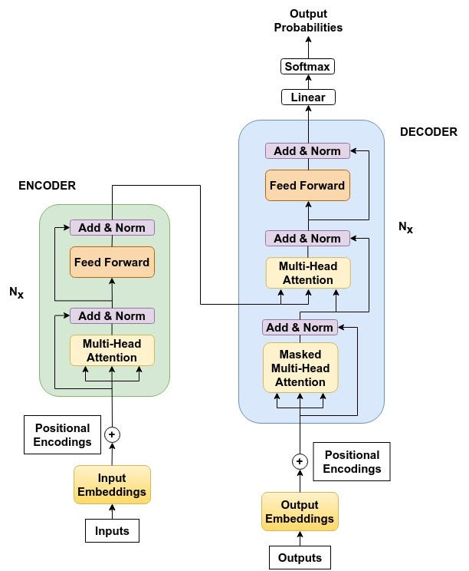
Transformer

Slide 11
Transformer
Attention Mechanism
Parallel Processing
Encoders and Decoders
Multi-Head Attention
Positional Encoding

Slide 12
Transformer
Attention Mechanism
Transformers use a self-attention mechanism to understand connections in the input.
This lets the model focus on important parts of the data, handling long sentences well.
It helps capture the meaning of words in relation to others, even in long texts.

Slide 13
Transformer
Parallel Processing
Unlike older models, transformers can work on different parts of a sentence at once.
This makes them faster, especially on modern computers.
They're efficient, handling tasks like translation or summarization quickly.

Slide 14
Transformer
Encoders and Decoders
Transformers have two main parts: an encoder and a decoder.
The encoder turns input text into a useful form for the model.
The decoder takes that and creates a response or translation.

Slide 15
Transformer
Multi-Head Attention
Transformers can pay attention to many parts of a sentence at once.
This helps them understand how different words relate to each other.
It's like looking at many words together to understand their meaning.

Slide 16
Transformer
Positional Encoding
Since transformers can't understand order like humans, they use positional encodings.
These show the model where each word is in the sentence.
It's important for the model to understand how words come together in a sequence

Slide 17
LLMs Project Statschat
Project Objective
Enhance the search experience on the Office for National Statistics (ONS) website
Utilize advanced NLP and Large Language Models
Investigate the ability to provide relevant text responses to search prompts by retrieving information from historical pages on the ONS website.

Slide 18
LLMs Project Statschat
Approach
Collect and store a historical archive of ONS publications since 2016.
Partition publications into chunks and convert them into vector embeddings using a sentence transformers model.
Employ an embedding search algorithm to collect the most relevant web pages from user queries.

Slide 19
LLMs Project Statschat
Approach
Utilize Generative Question-Answering (GQA) with the Flan-T5-Large model to answer user questions with paraphrased sentences from shortlisted documents.
Serve the application using Flask with a simple HTML front end and REST API endpoint for user interaction.

Slide 20
LLMs Project Statschat
Results and Performance
Embedding search showed clear improvement over the current website's search performance, particularly for specific queries.
Challenges encountered with broader questions, indicating areas for further improvement.

Slide 21
LLMs Project Statschat
Code base released as open-source on Github

Slide 22
LLMs: Challenges and concerns
Bias and Fairness
Reflecting biases present in training data
LLM used for hiring decision might favour certain demographic groups
Ethical Consideration
Misuse of misinformation or harmful content
Deepfake generation using LLMs
Hallucination
Opaque

Slide 23

Thank you

